Slide 1

Boolean Algebra
Notes:
目录

Slide 2
Boolean Algebra - Review
Boolean Algebra was proposed by George Boole in 1853.
Basically AND,OR NOT can be expressed as Venn Diagrams

Slide 3
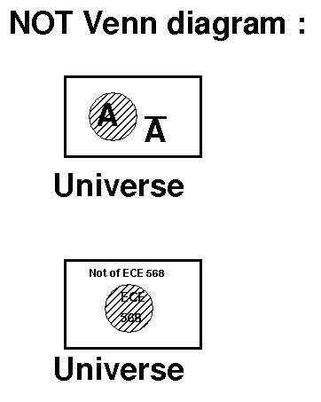
0
0

Slide 4
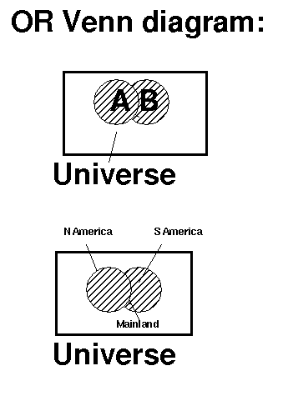

Slide 5
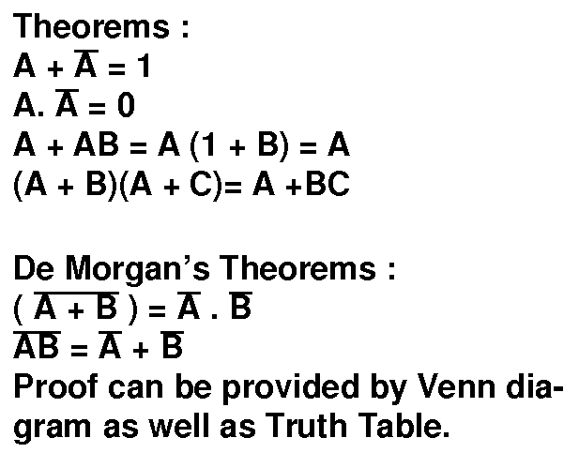

Slide 6
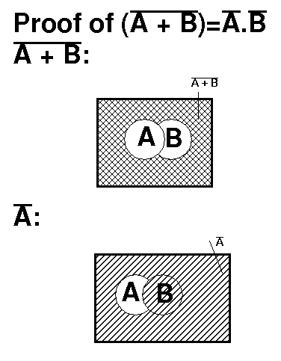

Slide 7
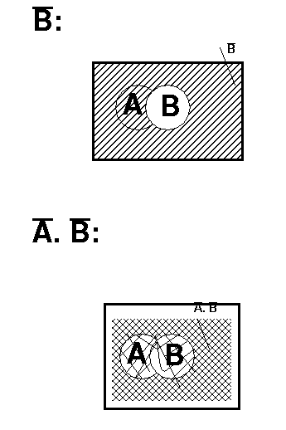

Slide 8
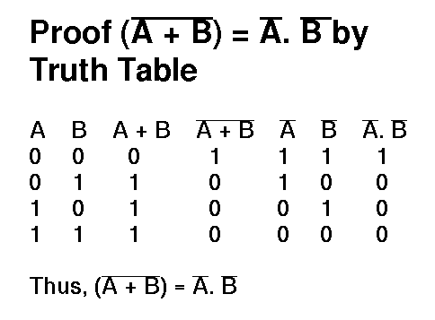

Slide 9
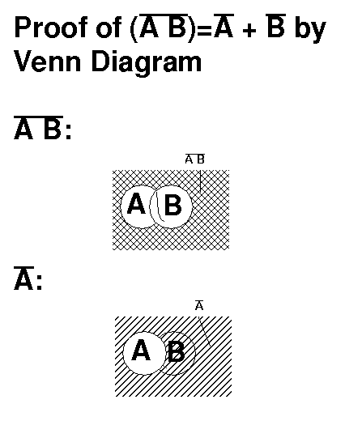

Slide 10
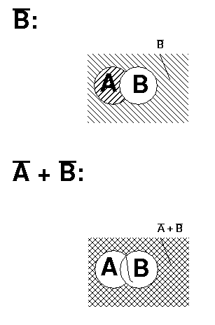

Slide 11
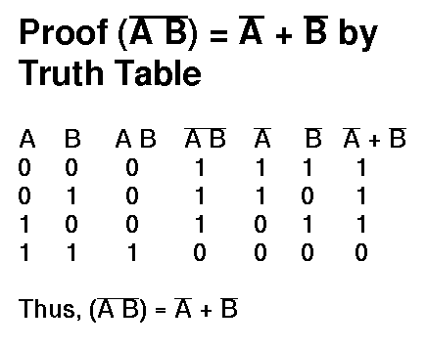

Slide 12
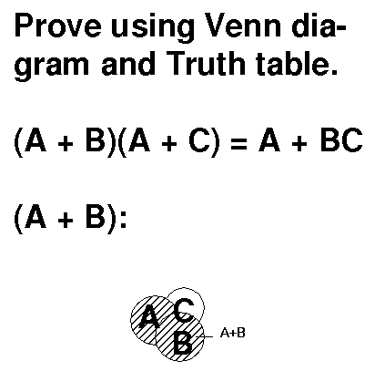

Slide 13
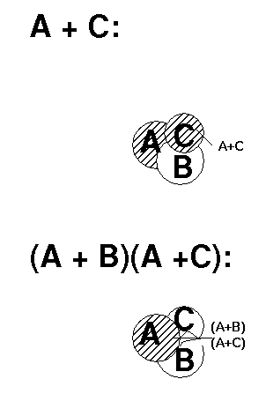

Slide 14
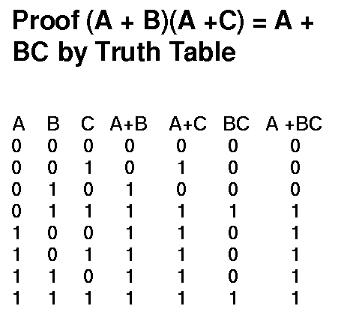
Proof (A + B)(A + C) = A + BC
By Truth Table

Slide 15
Min Terms and Max Terms
Min Terms are those which occupy
minimum area on Venn Diagram
Max Terms are those which occupy
maximum area on Venn diagram.

Slide 16
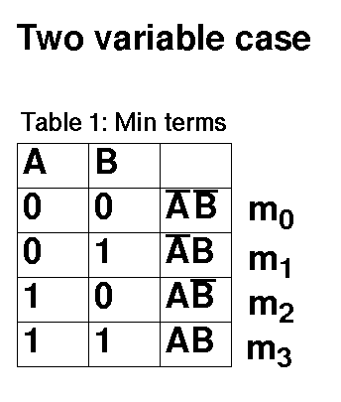

Slide 17
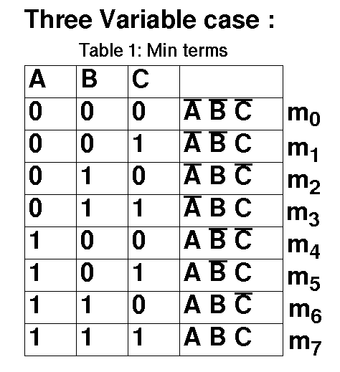

Slide 18
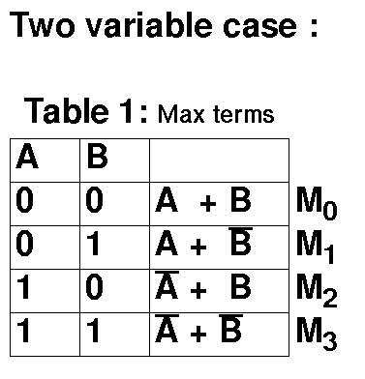

Slide 19
Logic Gates
Nand and Nor gates are called Universal gates
as any Boolean function can be realized with the
help of Nand and Nor gates only

Slide 20
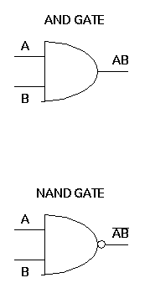
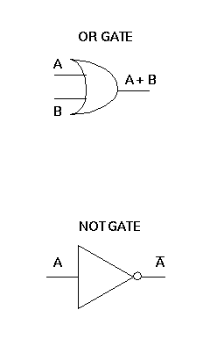
For example, NOT, OR, AND gates can be realized
by only Nand gates.

Slide 21
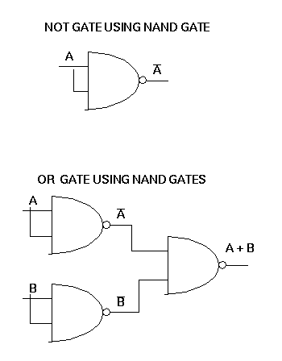

Slide 22
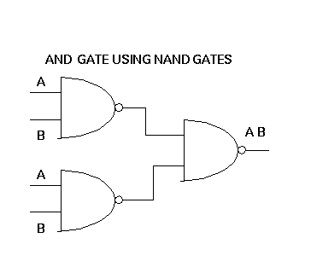

Slide 23
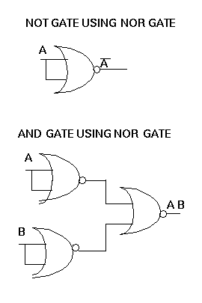

Slide 24
